Slide 1
MVC and JSP Models

Slide 2
What Is a MVC?
MVC stands for Model / View / Controller.
A software pattern where logic is separated from the model and view in order to provide for better reuse possibilities.
A software pattern recognized in the early days of small talk.

Slide 3
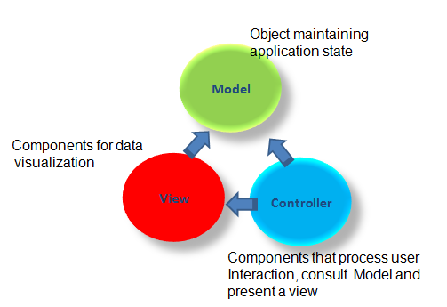
MVC Architecture

Slide 4
Web Application MVC Pattern
1
Controller (Servlet)
Model
Information is provided in objects or beans
View
The JSP provide the view
Controller
Servlet provides control logic and becomes the controller
2
Model (Beans)
3
View (JSPs)
4
View (JSPs)
5
View (JSPs)
View (JSPs)
View (JSP)

Slide 5
MVC - Model
Models data and behavior behind business process
Manages Information - If Changes
Contains data and Related Functionality
Maps Real-World Entities
Performing DB Queries
Calculating Business Process
Encapsulates Domain Logic which are independent of Presentation

Slide 6
MVC - Controller
Serves logical connection between user’s interaction and the business process
It receives and Translates input to request on model or view
Input from user and instructs the model and view to perform action
Responsible for making decision among multiple presentation
Maps the end-user action to the application response

Slide 7
MVC - View
Obtains data from model & presents to the user
Represents Output/Input of the application
Display results of Business Logic
Free Access to Model
Reads Data from Model – Using Query Methods

Slide 8
Relationship between Components
View and Controller
Controller is responsible for creating or selecting view
Model and Controller
Controller depends on model
If a change is made to the model then there might be required to make parallel changes in the Controller
Model and View
View depends on Model
If a change is made to the model then there might be required to make parallel changes in the view

Slide 9
Logical Layers in Web Application
public class DbBean{
public string userName { get; set; }
public string password { get; set; }
…
}
Model
<form method="post" action="Login">
<input type="text" name="txtUserName"></td>
<input type="text" name="txtUserName"></td>
…
<td>${u.userName} </td>
<td>${u.userPassword} </td>
View
protected void processRequest(HttpServletRequest request, HttpServletResponse response)throws ServletException, IOException {
String userName = request.getParameter("txtUserName");
String userPassword = request.getParameter("txtPassword");
User u = new User();
UserBO ubo = new UserBO();
u.setUserName(userName);
u.setUserPassword(userPassword);…
Controller

Slide 10
MVC Collaboration Diagram

Slide 11
Java 2 Web Applications
Java 2 web application options:
Servlets
+ Great for Java people
- Difficult to manage graphical changes in HTML layout.
JSP
+ Great for web developers
- Seductive tendency to write logic in the JSP page.

Slide 12
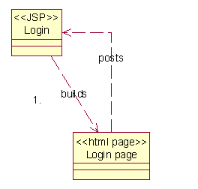
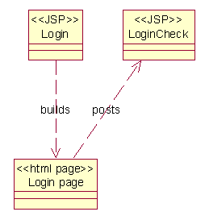
JSP Model 1
Web applications where JSP pages are used for every aspect of the development.
Option 1
Option 2

Slide 13
JSP Model 1 (cont.)

Slide 14
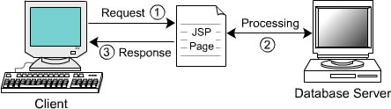
JSP Model 1 (cont.)
Represents a page-centric design
Composed of a series of interrelated JSP pages
Client request is directly processed by JSP page: handle all aspects of the application like presentation, control, and business logics
JSP page accesses the DB through JavaBeans to generate a response
Developed using scripting elements, custom tags, and a scripting language; Next page selection is determined by hyperlink or action of submitting a form
<a href=“find.jsp”> Search </a>
<form action=“find.jsp”> … </form>

Slide 15
JSP Model 1 (cont.)

Slide 16
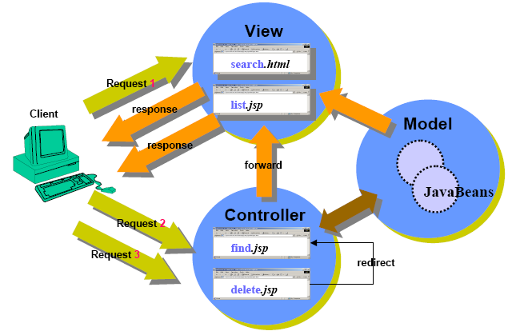
JSP Model 1 (cont.)

Slide 17
JSP Model 1 Observation
The Good
Easiest Solution
The Bad
Presentation and Logic are mixed.
The Ugly
No reuse possibilities
JSP1
JSP3
JSP2
JSP4
Presentation
Logic
Ctrl
Presentation
Presentation
Logic
Ctrl
Present.
Logic
Present.

Slide 18
JSP Model 1 Observation (cont.)
Advantages
Lightweight design – for small, static application
Suitable for small applications having very simple page flow, little need for centralized security control and logging
Separation of presentation from content
Limitations
Navigation Problem – to change name of JSP file have to change in many location
Applications are difficult to modify – large Java code being embedded in JSP page
Not suitable for large and complex applications

Slide 19
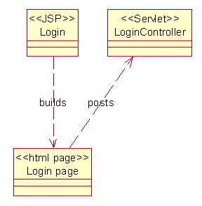
JSP Model 2
Web applications where JSP pages are used for the GUI aspect of the web development and the logic of the application is placed in the servlets it posts to.
Notes:
This provides the base for a model view controller architecture.

Slide 20
JSP Model 2 (cont.)

Slide 21
JSP Model 2 (cont.)
Represents a controller design
Based on Model-View-Controller (MVC) pattern
A combination of servlets, JSP and Java Beans
JSP pages are used only for presentation
Servlet handles initial request, partially process the data, set up beans, then forward the results to one of a number of different JSP pages
Servlet serves as a gatekeeper
Provides common services, such as authentication, authorization, login, error handling, and etc
Servlet serves as a central controller
Act as a state machine or an event dispatcher to decide upon the appropriate logic to handle the request

Slide 22
JSP Model 2 (cont.)
Servlet-centric Scenario

Slide 23
JSP Model 2 – Observation
Logic
Control
The Good
Reuse opportunities
Other application may be able to use the same code.
The Bad
There is no longer a one to one mapping from a view to a single source of code.
The Ugly
Takes more forethought.
JSP1
JSP3
JSP2

Slide 24
JSP Model 2 - Observation (cont.)
Advantages
Easier to build, maintain and extend: Suitable for large and complex applications
Single point of control (Servlet) for security and logging
Limitations
Increase Design Complexity

Slide 25
Questions?

